Slide 1
Udacity Connect Session
May 5, 2018
Deep Learning
Keras and Convolutional Neural Networks

Slide 2
Welcome back!

Slide 3
Morning Schedule
10:00 - 10:30 | Housekeeping, Review P4
10:30 - 11:00 | NN Architecture and Keras
11:00 - 11:30 | mNIST Notebook Session
11:30 - noon | Notebook Discussion
© 2016 Udacity. All rights reserved.

Slide 4
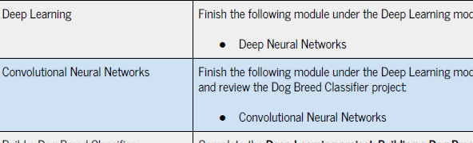

Slide 5
Activation Functions
Linear or Nonlinear
Possible input values float -∞ ≤ x ≤ ∞
Range (output) float 0 ≤ a(x) ≤ 1
Notes:
Activation function should be nonlinear, because the matrix operations are all linear. In order to use the network for non-linear functions activation function should be nonlinear.

Slide 6
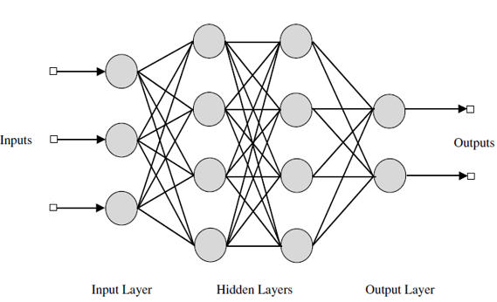
Multi-Layer Perceptron Network
Input
Bias
Output
Hidden
1
1
1
Notes:
Softmax is used in the output layer.
[The softmax function is often used in the final layer of a neural network-based classifier. Such networks are commonly trained under a log loss (or cross-entropy) regime, giving a non-linear variant of multinomial logistic regression.]
Activation functions f(x):
Sigmoid
TanH
Rectified Linear Unit (ReLU) – slope of 1
https://en.wikipedia.org/wiki/Activation_function

Slide 7
Notation
w₁₁x₁ + w₂₁x₂
w₁₂x₁ + w₂₂x₂
x₁ w₁₁ w₁₂
x₂ w₂₁ w₂₂
w₁₁
W₁^{T}x
W₂^{T}x
x₁
a⁽¹⁾
w₂₁
a⁽²⁾
x₂
a⁽¹⁾
W^{(1)T}x
a⁽²⁾ ⊗ W⁽²⁾ ⊗ a⁽¹⁾ ⊗ W⁽¹⁾ ⊗ x
Notes:
Backpropagation
ePoch https://www.quora.com/What-is-an-epoch-in-deep-learning

Slide 8
Matrix Dimensions
MATRIX MULTIPLICATION RULES
W_{ij} x W_{jk} -> W_{ik}
First index - number of units in the layer
Second index - number of outputs in the next layer
Number of units = number of perceptrons (features) + bias unit
Number of parameters - ij + jk + ..

Slide 9
Predictions and Cross-Entropy
Output layer activation Softmax = e^{x}/(1+e^{x})
Single class cross-entropy: 𝝨_{i} -p_{i}log(p_{i}) - (1-p_{i})log(1-p_{i})
Multi-class cross-entropy: 𝝨_{k} 𝝨_{i} -p_{ik}log(p_{ik})
i = count over all examples
k = count over all classes
Notes:
Ground truth is buried in the -p_{i}log(p_{i})
P the probability essentially a prediction.

Slide 10
Gradient Descent
MINIMIZE CROSS-ENTROPY
Chain rule of differentiation -- changes function composition into products
g(f(x)) -> g’(f)f’(x)
Choose weights
Calculate the predictions (probabilities)
Calculate the error function -- cross-entropy
Find the gradient (derivative) of the cross-entropy
Adjust weights (learning rate) in the direction of steepest descent
Repeat until convergence

Slide 11
Keras Layers
REPRESENTATION OF A SINGLE LAYER IN NN ARCHITECTURE
Number of input nodes
Activation function
Other parameters
Common Core layers
Input
Dense
Dropout
Flatten
Reshape

Slide 12
Keras Layers - Dense
https://keras.io/
keras.layers.Dense(units, activation=None, use_bias=True, kernel_initializer='glorot_uniform', bias_initializer='zeros', kernel_regularizer=None, bias_regularizer=None, activity_regularizer=None, kernel_constraint=None, bias_constraint=None)
Specify input_shape for first layer only

Slide 13
Keras Models
A MODEL IS A REPRESENTATION OF THE NETWORK
Sequential
Add layers one by one as defined by the architecture
Functional
Build model by passing in layers one-by-one as argument to previous model

Slide 14
Keras - Training
Define architecture
Define algorithm
Train (fitting parameters)
Model (Layers)
Compile (loss, optimizer, metrics)
Fit (data, labels, epochs,
batch_size, … )
Notes:
Similar to sklearn

Slide 15
Sequential Model
model = Sequential()
model.add( .. layer ..)
model.compile
model.fit
model.predict
model.fit_generator
model.predict_generator

Slide 16
Compile
https://keras.io/
keras.model.compile(optimizer, loss, metrics=None, sample_weight_mode=None, weighted_metrics=None, target_tensors=None)

Slide 17
Learning
https://keras.io/
keras.model.fit(x=None, y=None, batch_size=None, epochs=1, verbose=1, callbacks=None, validation_split=0.0, validation_data=None, shuffle=True, class_weight=None, sample_weight=None, initial_epoch=0, steps_per_epoch=None, validation_steps=None)

Slide 18
callbacks
https://keras.io/
History
ModelCheckpoint
LearningRateScheduler
EarlyStopping
Notes:
At the end of each epoch, callback calls all the above function.
The above manipulate the parameters.

Slide 19
zkhundkar/ConnectIntensive/
11a mnist_mlp

Slide 20
Lunch Break

Slide 21
Afternoon Session
1:00 - 1:45 | Convolutional Neural Networks
1:45 - 2:30 | Keras/TF - Notebook session
2:30 - 2:50 | Capstone Proposal
2:50 - 3:00 | Recap, Lookahead and Feedback
3:00 - 5:00 | Work on Projects (P4 or P5)
© 2016 Udacity. All rights reserved.

Slide 22
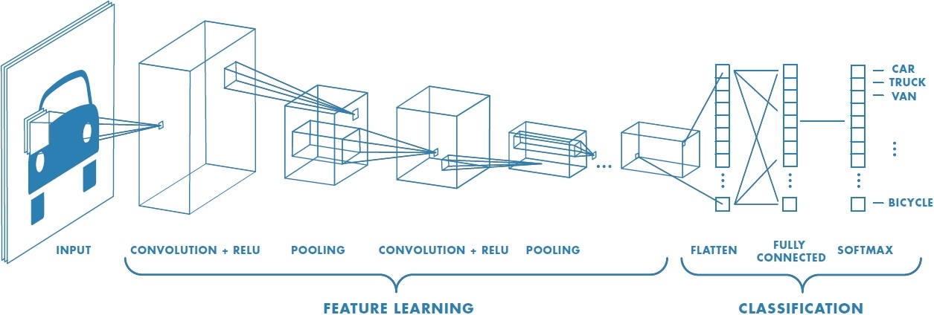
CNN Architecture

Slide 23
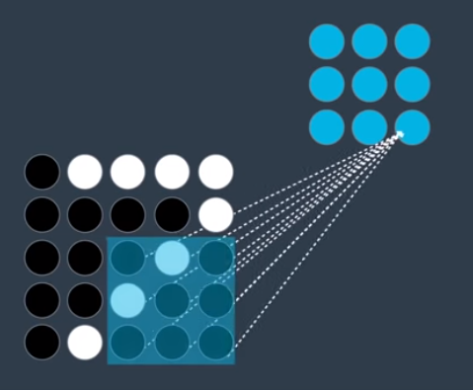

Slide 24
test
Convolutional Filter
Kernel Size
Very commonly 3x3
Stride
How many pixels to shift (typically 1)
Padding (dealing with edges)
“Valid” - stay within original image boundaries
“Same” - pad with zeros

Slide 25
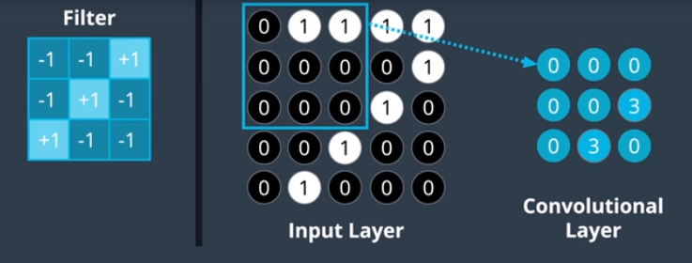
RELU ( SUM ( W * x ) )

Slide 26
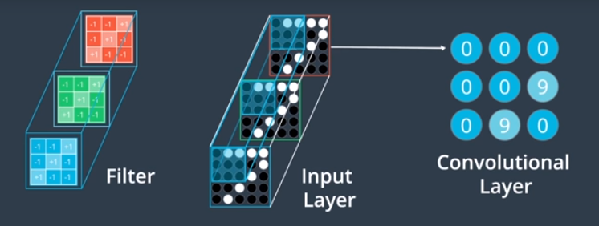

Slide 27
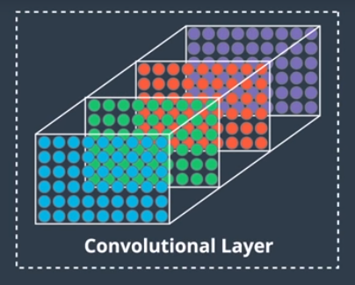

Slide 28
CNN Architecture

Slide 29
keras.layers.Conv2D(filters, kernel_size, strides, padding, activation='relu', input_shape)
keras.layers.MaxPooling2D(pool_size=(2, 2), strides=None, padding='valid', data_format=None)

Slide 30
Activate your python 3 environment
conda install keras, tensorflow
May need to install them separately
Start your jupyter session

Slide 31
Udacity/machine-learning/projects
/practice_projects/cnn/cifar10-classification
/cifar10_mlp
/cifar10_cnn

Slide 32
Prep for next week
Complete Smartcab Project (P4) due 4/28/18
Start on Dog Breed Project (P5) due 5/19/18
Convolutional Neural Networks (Lesson 2) complete
Augmentation, Transfer Learning, Style Transfer

Slide 33

We really need your Feedback!
© 2016 Udacity. All rights reserved.

